Slide 1
Performance testing using Jmeter

Slide 2
Agenda
Introduction
JMeter architecture
Features Supported by Jmeter
Prerequisites
Steps to install Jmeter
Jmeter Rest
Example 1: GET Request Example 2: POST Request

Slide 3
PERFORMANCE TESTING OF A RESTFUL API USING JMETER
Apache JMeter is open-source software that is popular for performance testing. This tool is designed to load test functional behavior and measure performance.
This document is about how to use JMeter for Performance Testing of a RESTful API. In this, we will learn how to configure JMeter and test a REST API to know how efficiently it works and how many concurrent users the server can handle
Wikipedia definition:
Apache JMeter is an Apache project that can be used as a load testing tool for analyzing and measuring the performance of a variety of services, with a focus on web applications.
JMeter can be used as a unit-test tool for JDBC database connections, FTP, LDAP, Webservices, JMS, HTTP, generic TCP connections and OS native processes. One can also configure JMeter as a monitor, although this is typically considered ad hoc rather than advanced monitoring. It can be used for some functional testing as well.
JMeter architecture working process:
JMeter simulates number of users send request to an appropriate server which shows the performance/functionality of an appropriate server / application via tables, graphs etc. The figure below depicts this process:

Slide 4
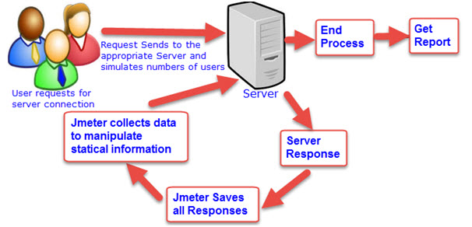
JMeter Architecture

Slide 5
Features Supported by JMeter:
People really think of that why they should go for JMeter?
So, to clear their drought, let us get to know JMeter awesome features,
Open source application: JMeter is a free open source application which facilitates users or developers to use source code for other development or modification purpose.
User – friendly GUI: JMeter comes with natural GUI. It is very simple and easy to use and users get familiar very soon with it.
Platform independent: Although, it is totally a Java based desktop application. That’s why; it can run on any platform. It is highly extensible and capable to load the performance test in many different server types: Web – HTTP, HTTPS, SOAP,Database via JDBC, LDAP, JMS, Mail – POP3.
Write your own test: Using plugins, write your own test case to extend the testing process. JMeter uses text editor to create a test plan and supplies in XML format.

Slide 6
Support various testing approach: JMeter supports various testing approach such as Load Testing, Distributed Testing, and Functional Testing, etc.
Simulation: JMeter can simulate various users with simultaneous threads, generate heavy load against web application under test.
Support multi-protocol: JMeter works on web application testing and database server testing, and also supports protocols such as HTTP, JDBC, LDAP, SOAP, JMS, and FTP.
Script Test: JMeter is capable to perform automation testing using Bean Shell &Selenium.
Totally multi-threading framework:. It’s a full multi-threading framework permits simultaneous sampling by many threads and simultaneous sampling of different functions by distinct thread groups.
Easily understandable test result: It visualizes the test result in a format such as chart, table, tree and log file are very simple to understand.
Easy installation step: Just run the“*.bat” file to use JMeter. In Linux/Unix – JMeter can be approached by clicking on JMeter shell script. In Windows – JMeter can be approached by starting the JMeter.bat file.

Slide 7
Prerequisites
Before proceeding with this tutorial, you should have a basic understanding of Java programming language and JDK 1.6 or above, text editor and execution of programs, etc., because you are going to use jMeter to handle all levels of Java project testing (regression, functional, load, performance, etc.,), so it will be good if you have knowledge of software development and software testing processes.

Slide 8
Steps to install Jmeter:
Follow this link.
https://www.guru99.com/guide-to-install-jmeter.html
Steps:
Step 1) Install Java : JMeter is pure Java desktop application, it requires a fully compliant JVM 6 or higher
Step 2) Download Jmeter : version 3.2
Step 3) Installation: Installation of JMeter is extremely easy and simple. You simply unzip the zip/tar file into the directory where you want JMeter to be installed. There is no tedious installation screen to deal with! Simple unzip and you are done!
/bin: Contains JMeter script file for starting JMeter
/docs: JMeter documentation files
Step 4) Launch JMeter
You can start JMeter in 3 modes 1)GUI Mode 2)Server Mode 3)Command Line Mode
For this, we created a RESTful API that lets you do the operations like GET on a Product( openweathermap). A Product is an API which is used to Access current weather data for any location on Earth including over 200,000 cities and to update weather information.

Slide 9
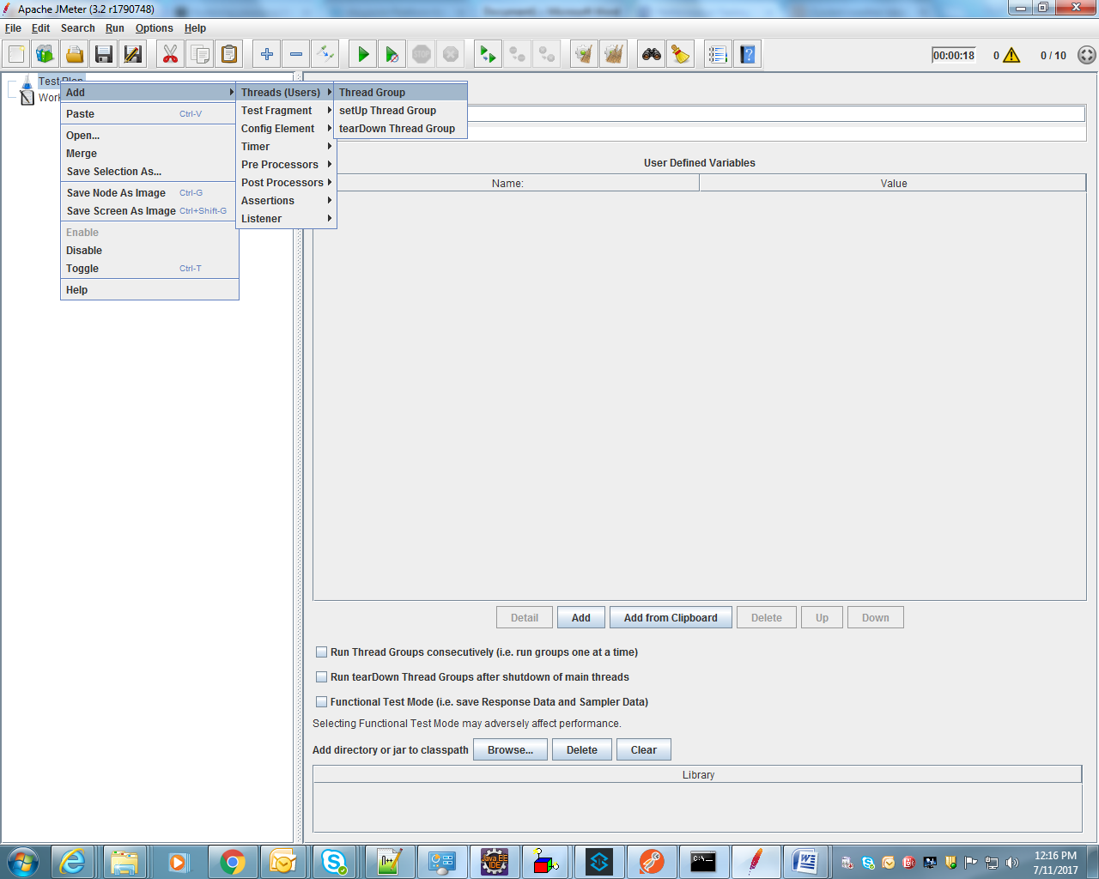
Step 1:

Slide 10
Step 2:
Right click Test Plan. Select Add → Threads (Users) → Thread Group. Add the thread group.
a. Set the name to “Item API Perf Test”
b. Set the number of threads (users) to 10
c. Set the Ramp-Up period (in seconds) to 10
d. Set the Loop count to 10
So we will have 10 users executing the test plan 100 times. The Ramp-Up Period tells JMeter how long to delay before starting the next user.

Slide 11
Terminology
1) Thread Count
Thread Count defines the number of Users you want to simulate for the execution.
2) Setting the Ramp-Up Time
Ramp-Up is the amount of time Jmeter should take to get all the threads sent for the execution. Ramp-Up should be sufficient enough to avoid unnecessary and large work load from the beginning of the test execution.
For example, if Thread Count is 10 and the ramp-up period is 100 seconds, then Jmeter will take 100 seconds to get all 10 Threads up and running. First thread will be sent on 0th second (beginning of the execution) and then each thread will start after 10 seconds(100/10).
3) Loop Count
Using Loop Count you can specify the number of times to execute the Performance Test. You can select check-box “forever”, it will keep on executing same Test script in loop until you manually stop the execution. There is also an option to manually define the loop count.
Now let’s look at some examples to understand Thread Count + Ramp-Up Time + Loop Count combination.
– Scenario 1 : Thread Count = 20, Ramp Up Time (Seconds) = 100 & Loop Count = 1
Every 5 seconds (100/20) one Thread / Request will hit the server. Execution will start with one request at a time.
– Scenario 2 : Thread Count = 20, Ramp Up Time (Seconds) = 100 & Loop Count = 4
Every 5 seconds (100/20) 4 Thread / Requests will hit the server. Once the first thread completes the first round of execution, it will start 2nd loop by executing same HTTP request. Execution lasts until all 20 threads executes all HTTP requests 4 times.

Slide 12
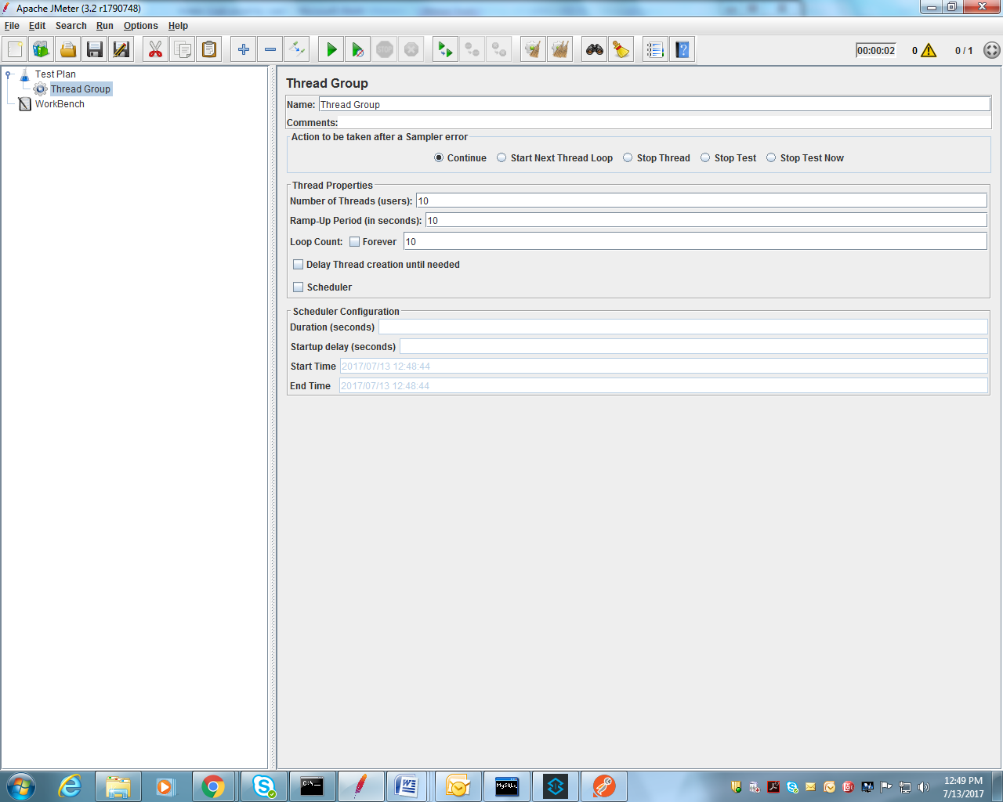

Slide 13
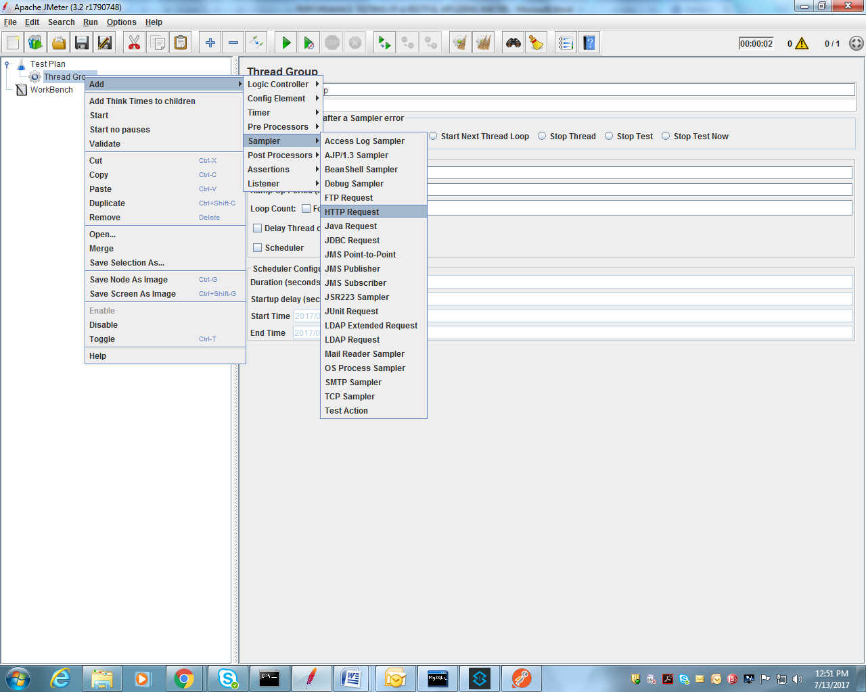
Step 3:Thread group->Add->Sampler->HTTP Request
Sampler: Samplers tell JMeter to send requests to a server and wait for a response. They are processed in the order they appear in the tree.

Slide 14
Step 4:Refer this API
Required credentials:
http://openweathermap.org/appid
http://samples.openweathermap.org/data/2.5/weather?q=London,uk&appid=b1b15e88fa797225412429c1c50c122a1
server name or ip :samples.openweathermap.org
path: data/2.5/weather
q=London,uk
appid=b1b15e88fa797225412429c1c50c122a1

Slide 15
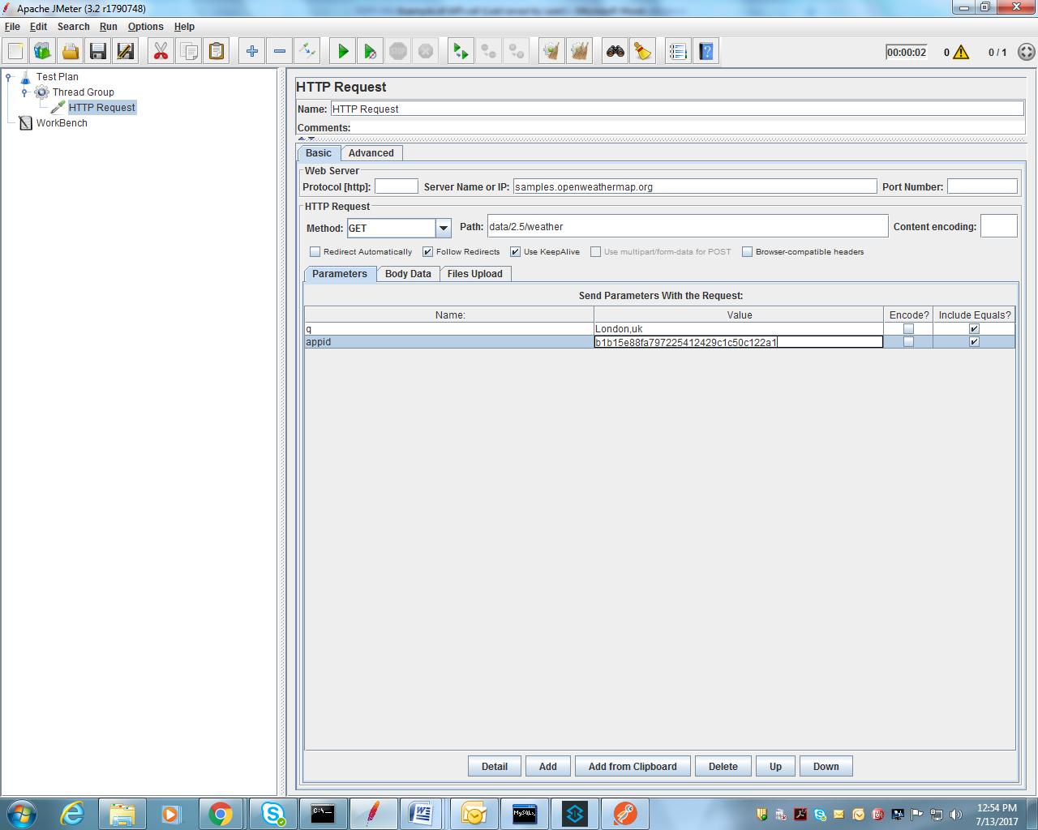

Slide 16
Step 5: To view the result:
1)Thread group->Add->Listener->view result Table
2)Thread group->Add->Listener->view result Tree
The View Results in a Table shows the results of test plan in tabular format. Let's see an example of this listener in use.
The View Results in a Tree shows the results of test plan in tree structure. Let's see an example of this listener in use.

Slide 17
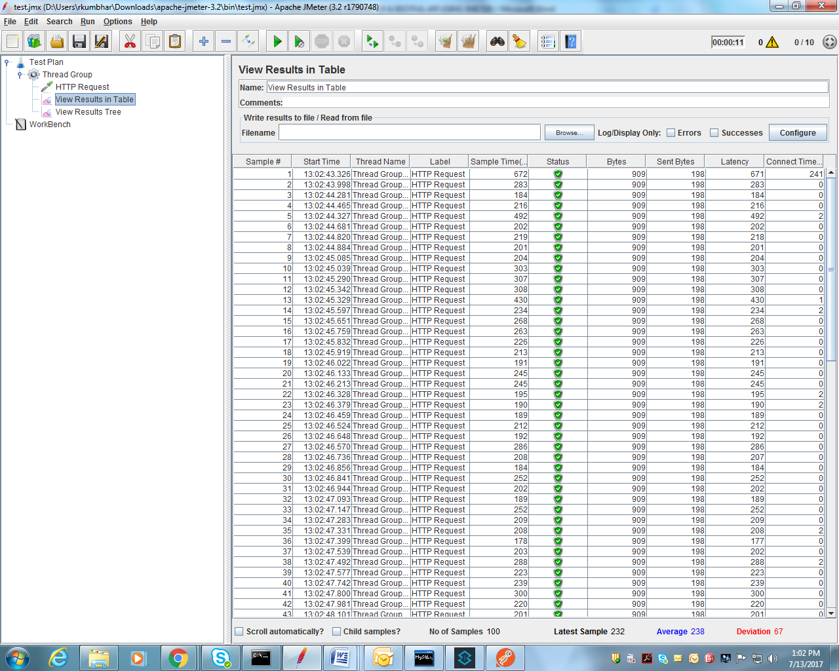

Slide 18
Field explanation
Field | Description | Value Example
TimeStamp | in milliseconds since 1/1/1970 | 1354223881017
label | Request Type | HTTP Request
ThreadName | Name of the thread | Thread Group 1-1
status | true or false | true
bytes | number of bytes in the sample | 34908
Start time | Start time of thread | 13:08:25.830
latency | time to first response | 132

Slide 19
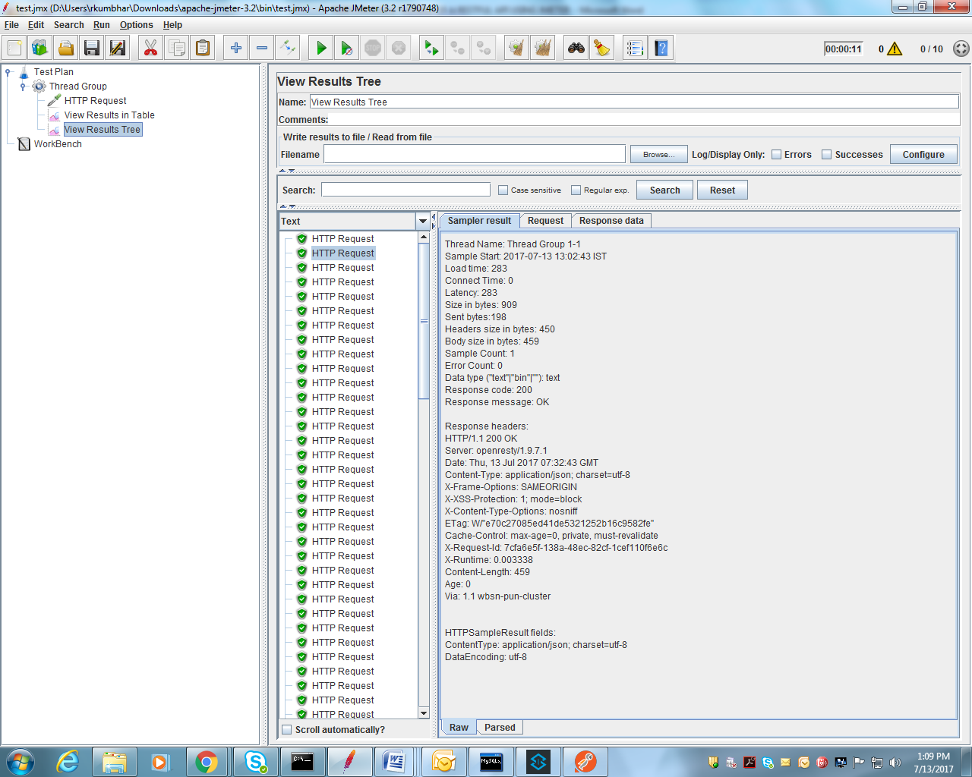
View Result Tree:

Slide 20
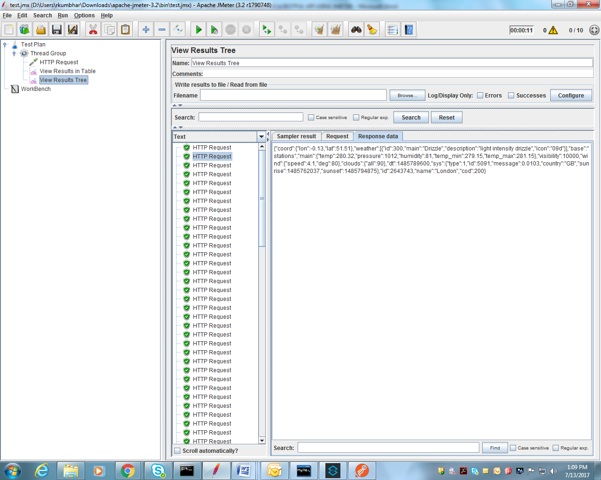
Expected Output:

Slide 21
Click link below for jmx file

Slide 22
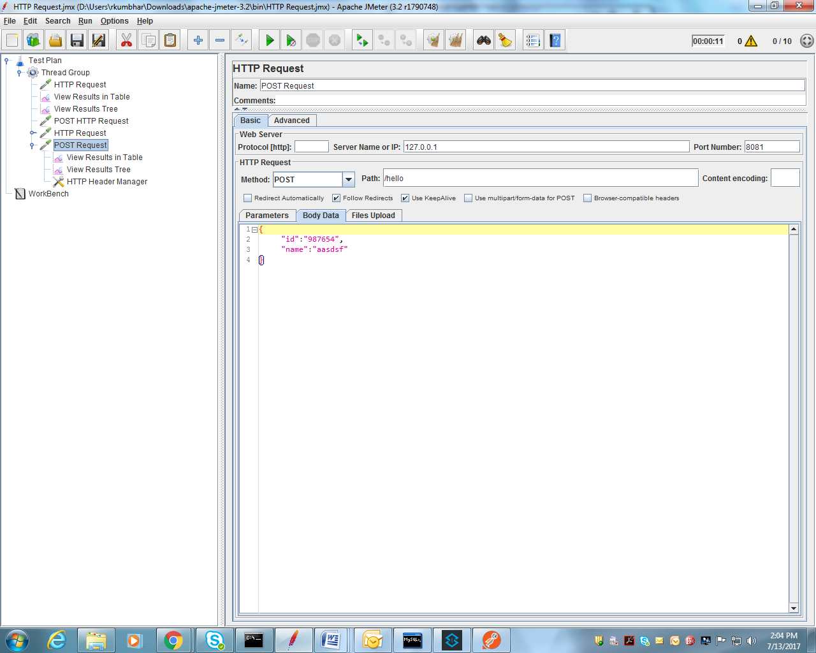
Example 2: POST Request
Step 1: Create a POST request and add the required format data.

Slide 23
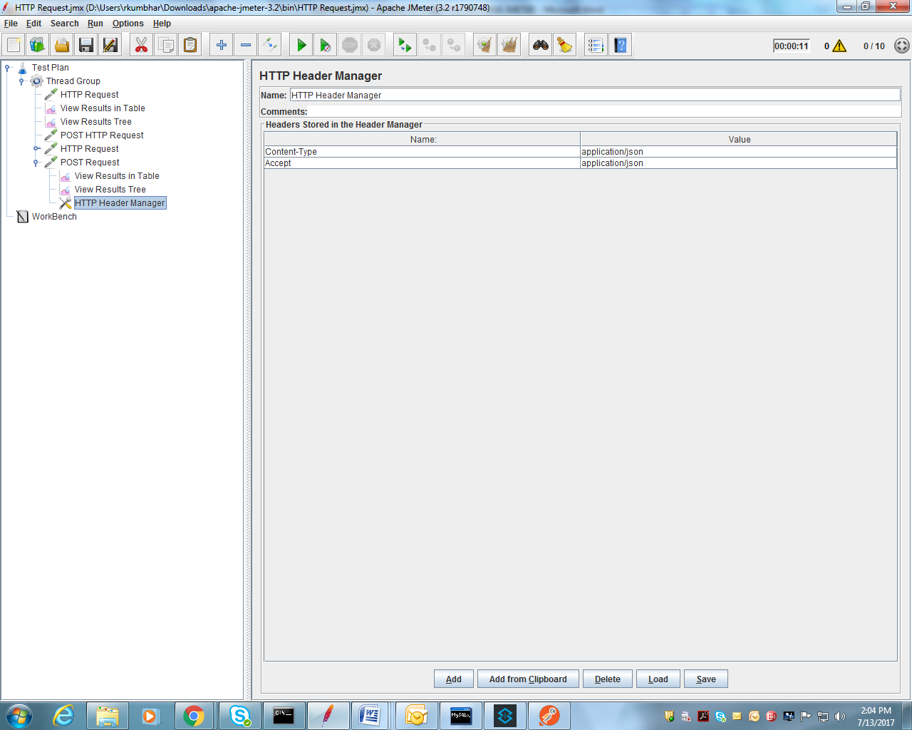
Step 2: Add Content-Type and Accept data . e.g. application/json or application/xml etc.

Slide 24
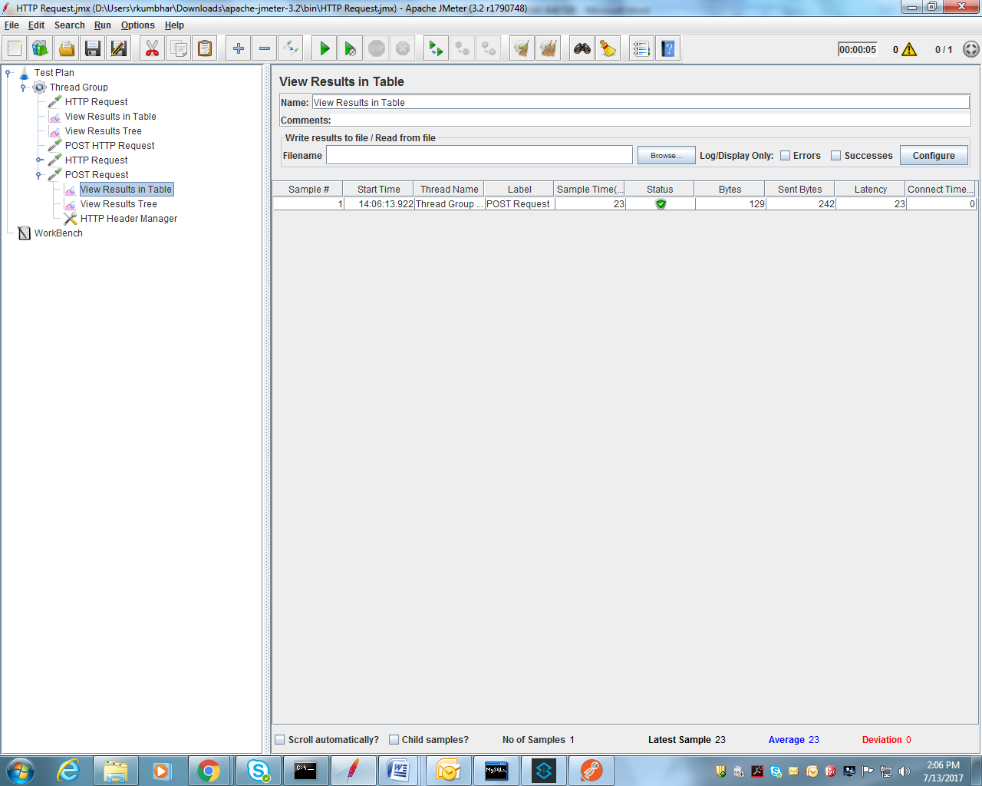
Result Table:

Slide 25
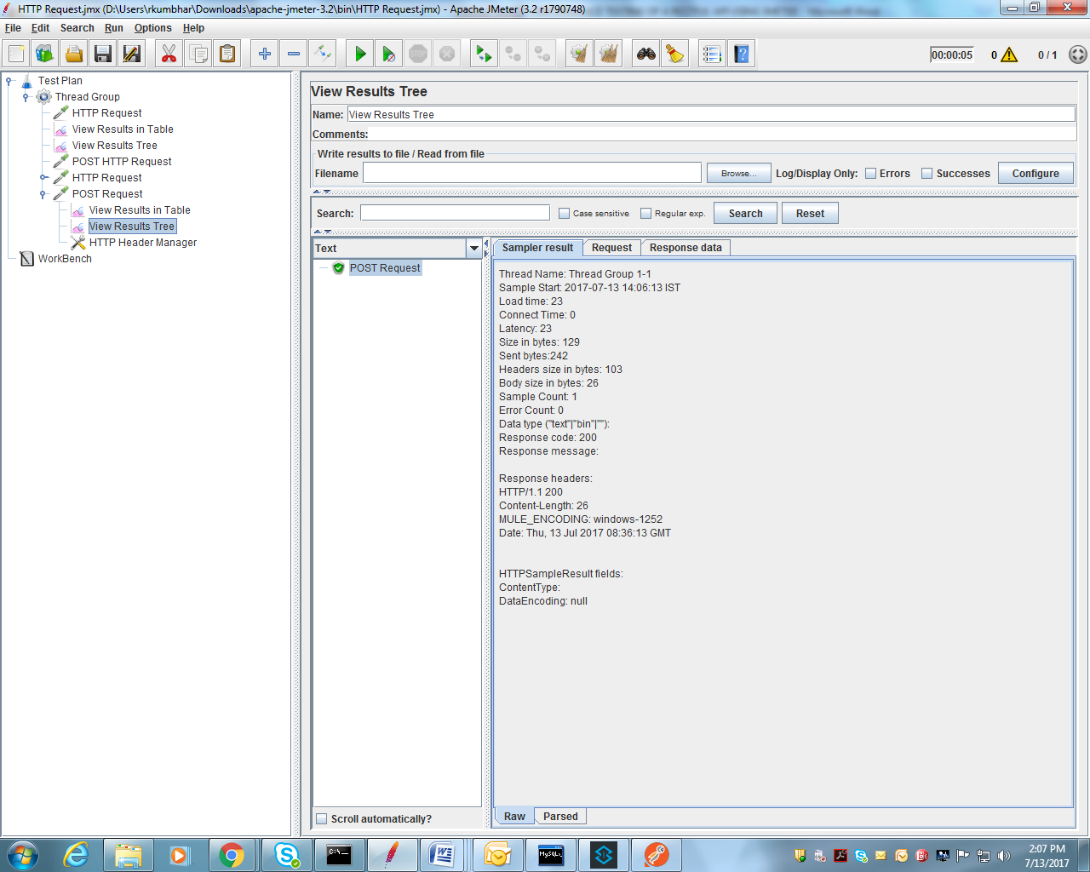
Expected Response:

Slide 26
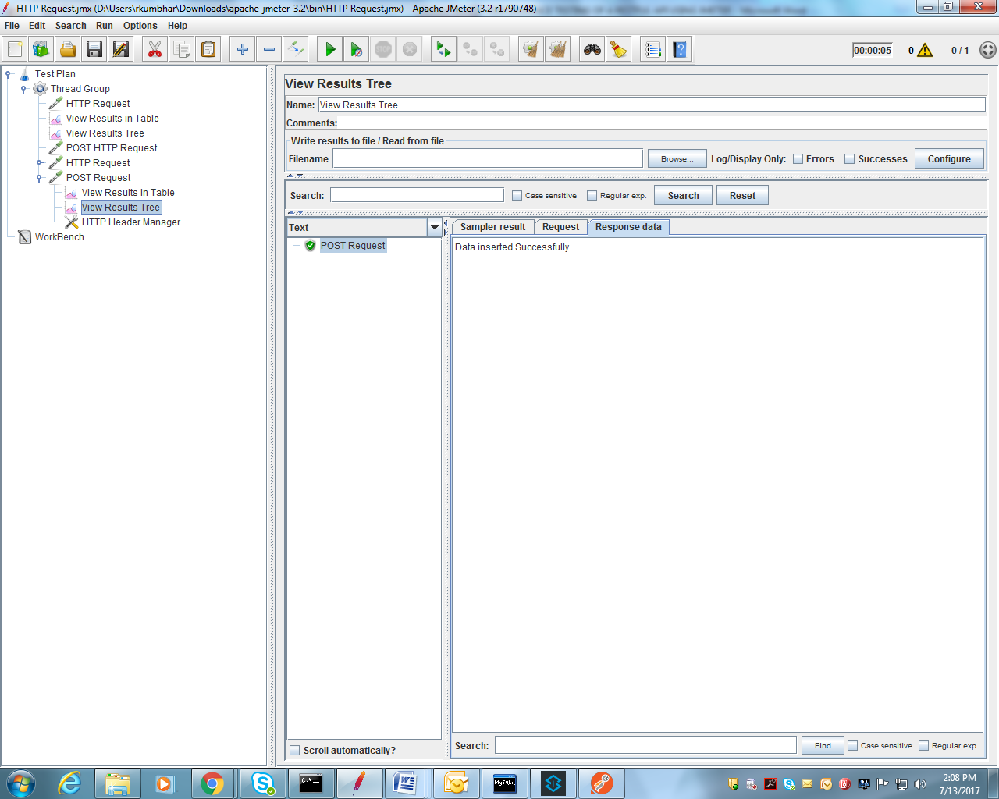

Slide 27
Click below link to open jmx file

Slide 28
Thank you

